Slide 1
Wireless doorbell project
By Ariel Kamen

Slide 2
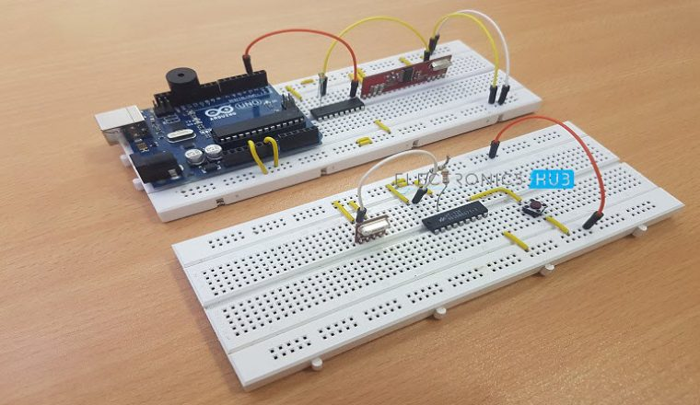
The Project
A wireless doorbell for me to put on my wall.
https://www.electronicshub.org/wireless-door-bell/

Slide 3
How it works
The wireless doorbell will use an RF (radio frequency) transmitter and receiver to send signals. These signals will first go through an encoder so as not to get confused with other signals, and will be decoded at the receiver. If the receiver receives the proper signal, it will ring a buzzer to alert me that someone is at the door.

Slide 4
Materials (that I don’t already have)
434 MHz RF Transmitter Module $3.95 https://www.sparkfun.com/products/10534
HT – 12E Encoder IC $8.98 https://www.amazon.com/gp/product/B00B88FNW8/ref=ox_sc_act_title_3?smid=A2LM4S0G8N062T&psc=1
750 KΩ Resistor
Power Supply(pack of 8) $9.99 https://www.amazon.com/AmazonBasics-Everyday-Alkaline-Batteries-8-Pack/dp/B00MH4QM1S
434 MHz RF Receiver Module $4.95 https://www.sparkfun.com/products/10532
HT – 12D Decoder IC $4.77 https://www.amazon.com/gp/product/B00DJUIGM2/ref=ox_sc_act_title_2?smid=A39WMSZNCSP1QK&psc=1
Prototyping Board (Breadboard) $5.69 https://www.amazon.com/gp/product/B0135IQ0ZC/ref=ox_sc_act_title_1?smid=A12MRQC2NA7LMA&psc=1

Slide 5
Schedule
Feb 1:
Have all the parts and have the wires and all non-building required parts hooked up.
Create a sketchup of the base of the doorbell
Feb 28:
Have the doorbell successfully working.
Record range of the RF connection.
Mar 30:
Have a base for the doorbell and receiver. Have any last-minute adjustments done
April 30: Doorbell!

Slide 6
Challenges and risks
The range on the receiver and doorbell might not be long/strong enough to resonate through the wall. The power supply might not last very long.

